Slide 1
The Battle of Neighborhoods
The city of Toronto

Slide 2
Introduction
The strength and vitality of the many neighborhoods that make up Toronto, Ontario, Canada has earned the city its unofficial nickname of "the city of neighborhoods." There are over 140 neighborhoods officially recognized by the City of Toronto and upwards of 240 official and unofficial neighborhoods within city limits. Before 1998, Toronto was a much smaller municipality and formed the core of Metropolitan Toronto.

Slide 3
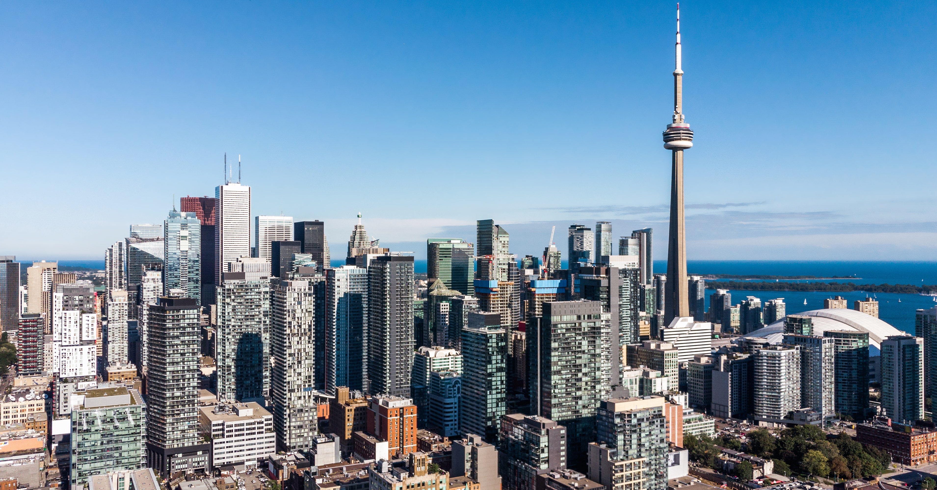
Image of the beautiful city of toronto

Slide 4
The "inner ring" suburbs of York and East York are older, predominantly middle-income areas, and ethnically diverse.
The "outer ring" suburbs of Etobicoke, Scarborough, and North York are much more suburban in nature (although these boroughs are developing urban centers of their own, such as North York City Centre around Mel Lastman Square).

Slide 5
Problem Statement
The idea is to find a neighborhood in Toronto city of Canada that has all the basic necessities shops within kilometers of the living place.
The Foursquare API will be used to find all the nearby venues in neighborhoods and retrieve categories and count of shops in each category for each neighborhood.

Slide 6
Methodology
The aim of the project is to get the best neighborhood according to places near it. For that, the longitude and latitude of each neighborhood were required. The GeoSpatial data contains Postal codes, Longitude, and Latitude data for all the 103 Boroughs of Toronto city.
The two datasets were combined and the new dataset with boroughs, neighborhoods, and latitude and longitude was prepared.

Slide 7
The next step was to retrieve nearby places in each neighborhood. The Foursquare API was used for this purpose.
K-means clustering with 5 clusters was used on the dataset. The features of clustering were those 7 categories retrieved in the previous step. The frequency of occurrence of each category determined clusters of neighborhoods.

Slide 8
Data Acquisition
Data of boroughs and neighborhoods of the Toronto City would be retrieved from Wikipedia (https://en.wikipedia.org/wiki/List_of_neighbourhoods_in_Toronto).
The Geospatial data would be used to retrieve the Longitude and Latitude of each neighborhood. Then, Foursquare API would be used to retrieved nearby venues of each neighborhood.

Slide 9
Libraries used in the Project
Pandas: For creating and manipulating data frames
Folium: Python visualization library
Scikit Learn: For importing k-means clustering
Beautiful Soup and Requests: To scrap and library to handle http requests.

Slide 10
JSON: Library to handle JSON files.
XML: To separate data from presentation and XML stores data in plain text format.
Geocoder: To retrieve Location Data.
Matplotlib: Python Plotting Module.

Slide 11
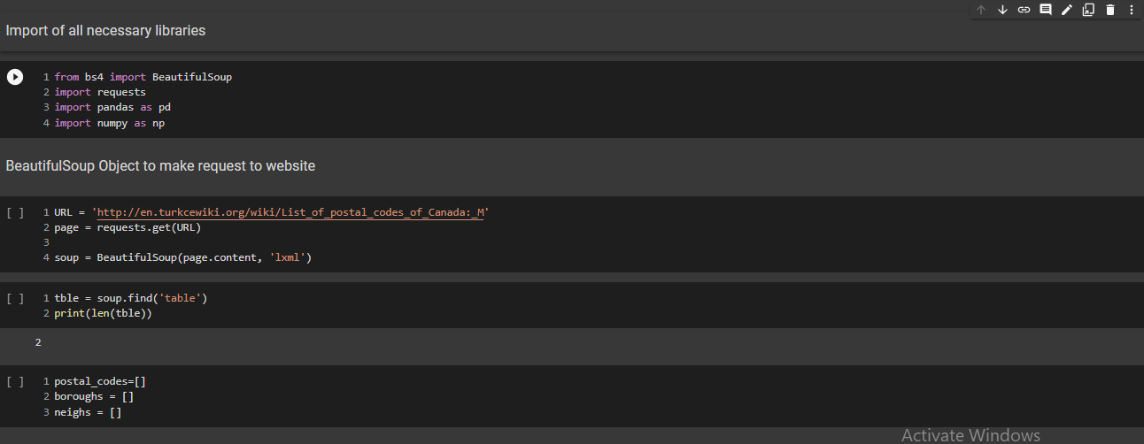
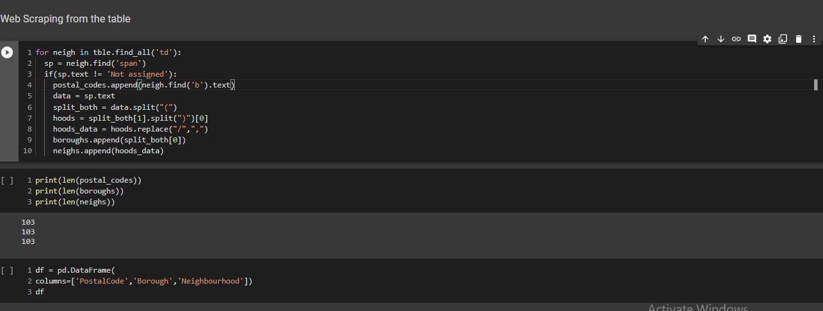
Importing the libaries and scrapping data from wikipedia using beautiful soup

Slide 12
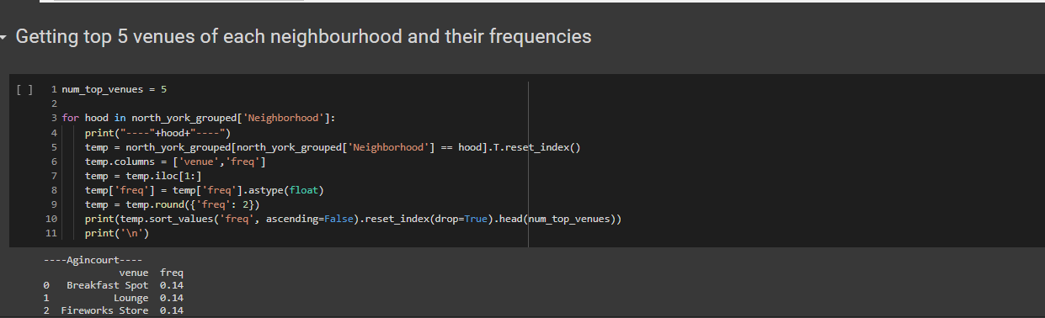
K-means clustering with 5 clusters was used on the dataset. The frequency of occurrence of each category determined clusters of neighborhoods.

Slide 13
Results and Discussion
There are 5 different clusters of neighborhoods. Red and Purple clusters have more neighborhoods compared to other clusters.
The red clusters are mostly on the airport side of the City which seems less populated.
Purple neighborhoods are near University of Toronto and beach side.

Slide 14
The yellow cluster is of neighborhoods which are very far from main city area.
The sea blue cluster has only one neighborhood in it which is inside city region but it is only one neighborhood in the area.
The Cyan clusters are nearly on the border of the city.

Slide 15
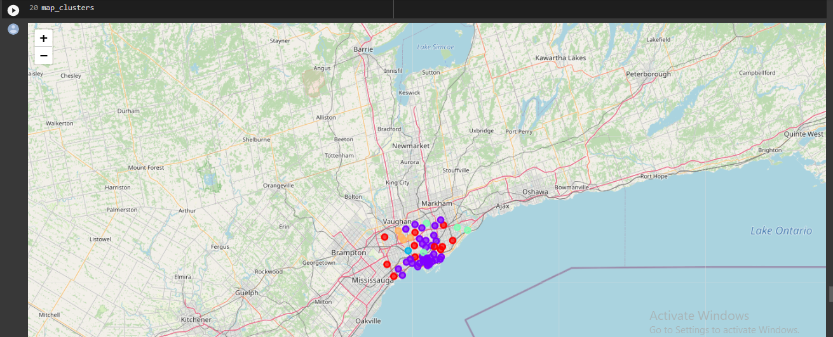
The map showing the result of the 5 clusters

Slide 16
Conclusion
The project overall helps people select the best neighborhood to live in. The other aspect of the project may help shop owners and businessmen to determine what kind of shops would be required in the area.

